Slide 1
Project PTO – Building a Computer Algorithm to Predict the Oscars

Slide 2
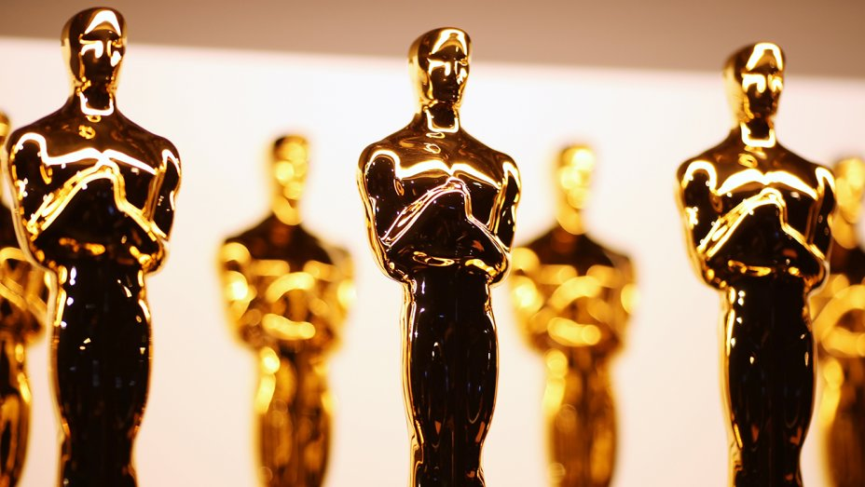

Slide 3
Overview
Method
Process
Takeaways

Slide 4
Results
Mode A: ML Algorithm
Mode B: Research Report

Slide 5
For the last 4 weeks, I developed a machine learning algorithm to predict the Oscars. Not just the winners, but also the nominees, in 6 categories: Best Picture, Leading Actor, Leading Actress, Supporting Actor, Supporting Actress, and Animated Film. I chose this project because I love movies and always watch the Oscars, and I’m pursuing CS major, so this project is the best of both worlds.
Data: Existing dataset + Web-scraping
Algorithm: Using Keras Functional API, MLP of hidden layer of 128 nodes w/ ReLU + 6 output layers of 3 nodes w/ Softmax
Results: 98.4% accuracy for the 2018 Oscars
Mentor: John Ciancutti, a Google director/scientist

Slide 6
1
2
3
4
Data Manipulation
/ Organization
Data Collection
Algorithm
Algorithm Optimization

Slide 7
Week 1: Data Collection
Met w/ mentor and narrowed down project from movie recommendation system to Oscar prediction algorithm
Found BIGML dataset
Web-scraped list of movies from IMDB
Week 2: Data Collection + Manipulation
Web-scraped input variables / details for all the movies collected (duration, certificate, IMDB rating, metascore, number of critic reviews, etc)
Web-scraped results on how movies did at previous award ceremonies (Golden Globes, BAFTA, Producers Guild, OFTA, etc)
Made point system for awards where winner = 1 point, nominee = 1/(number of nominees) point, nothing = 0 points
Incorporated into input feature vector
Week 3: Data Manipulation + Algorithm
Incorporated/organized all the web-scraped data into a dataset
Got rid of unnecessary data
Tried various ML classifiers: SVM, Decision Trees, Random Forests
Decided on neural network config
Week 4: Algorithm + Optimization
Not working properly w/ predicting results for 24 Oscar categories → simple version: win, nominee, or nothing?
Narrow down prediction to 6 Oscar categories due to lack of data
Dealing with imbalanced dataset, trying different model architectures (hidden layer size, loss functions, class weights, activation functions, etc)

Slide 8
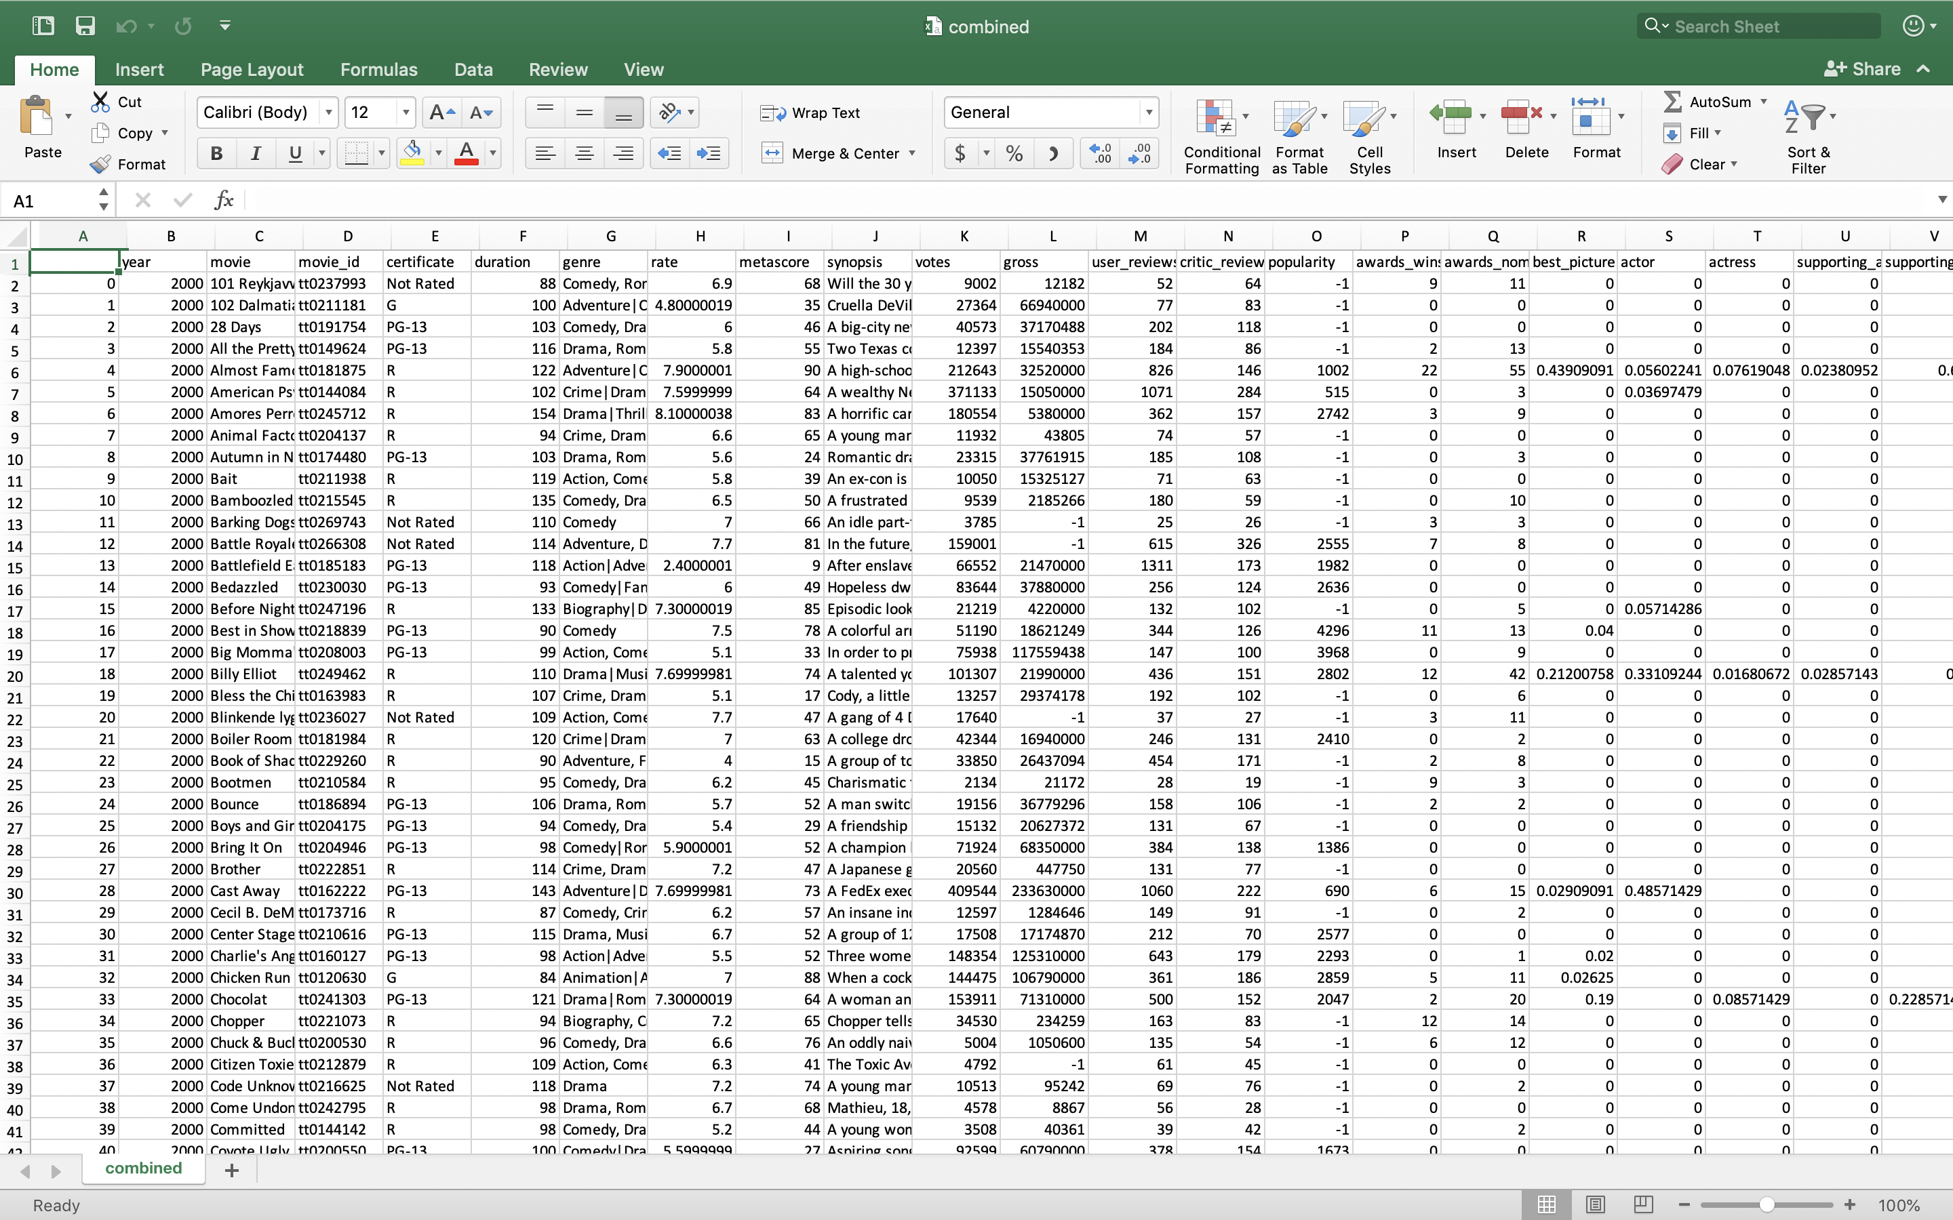

Slide 9
Plan out ahead / break it down
Always start with a simpler problem
Importance of data analysis
Ask as many questions as possible
Use a bigger font
Should keep good documentation
Chances are, someone already did it

Slide 10
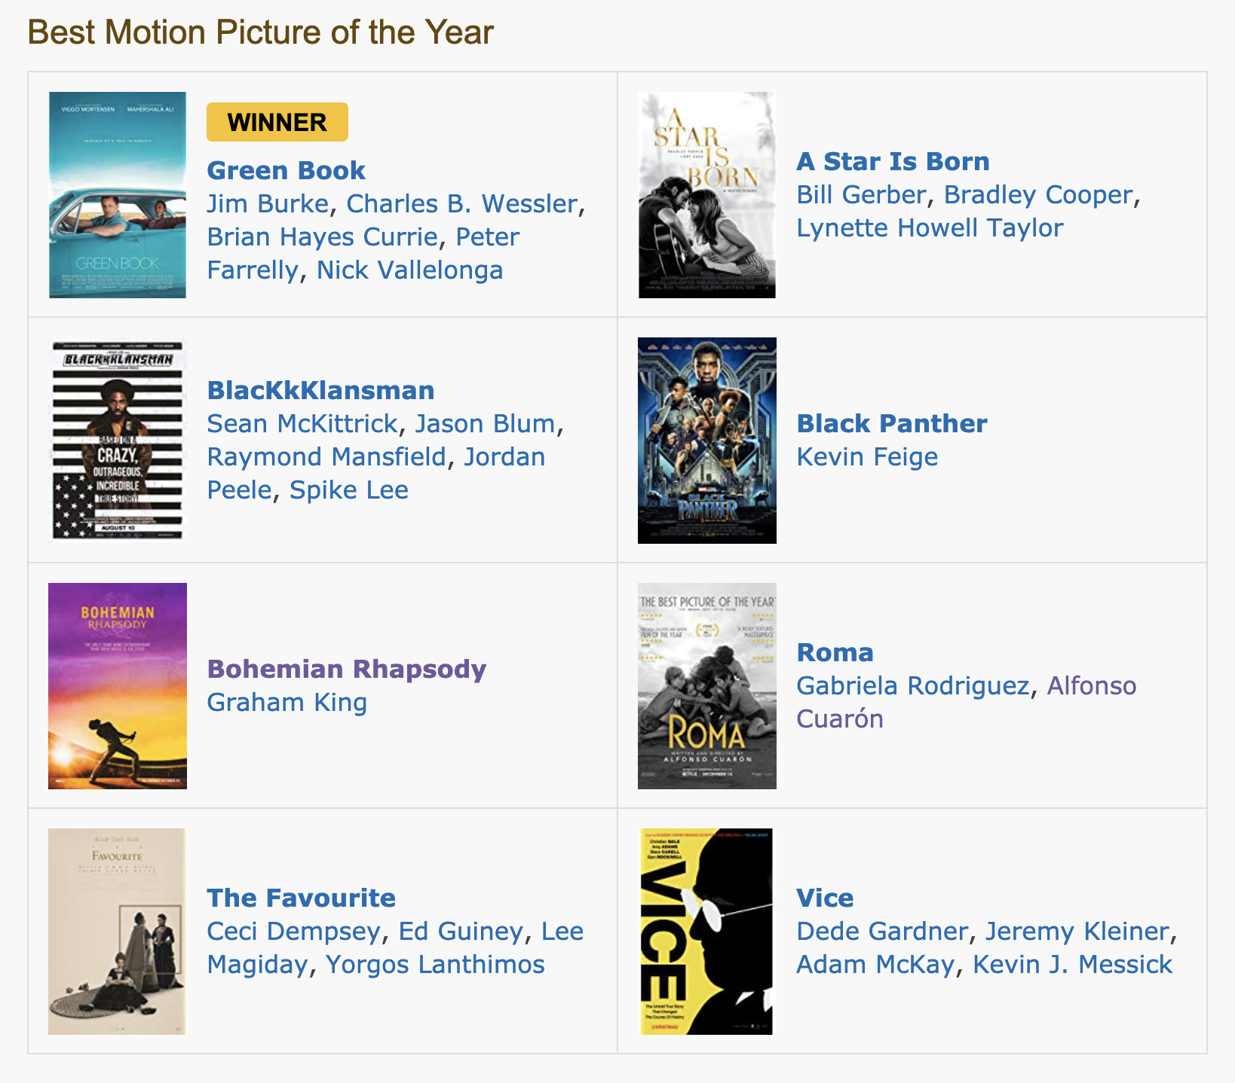
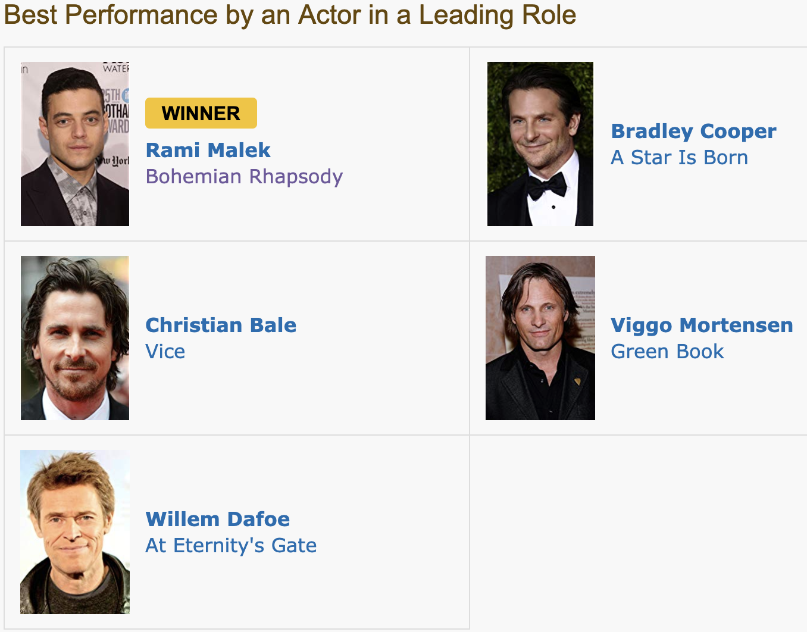
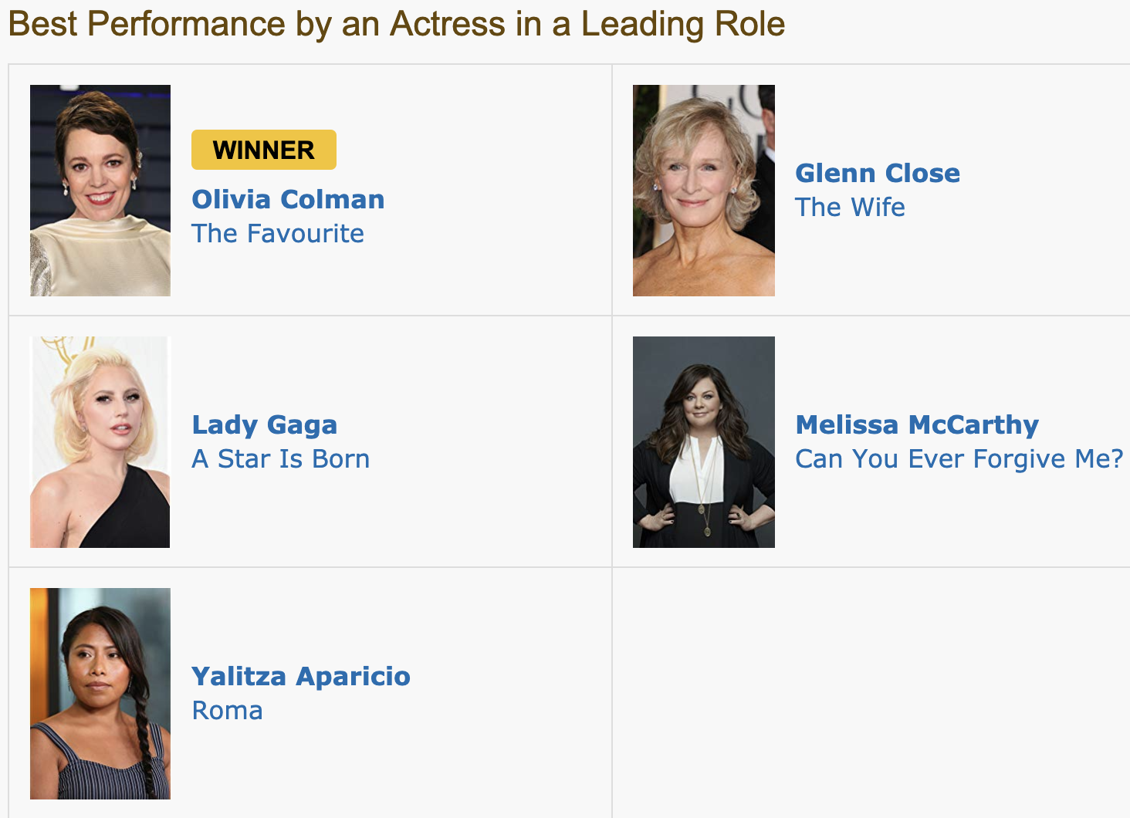
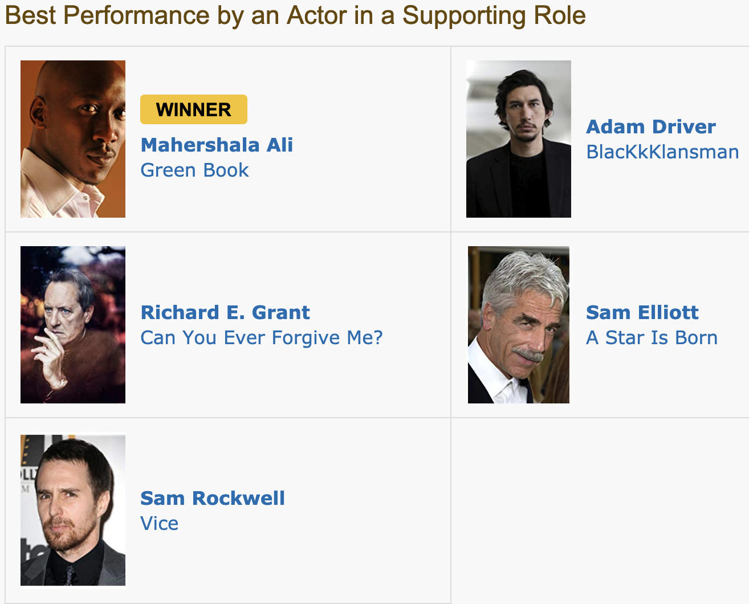
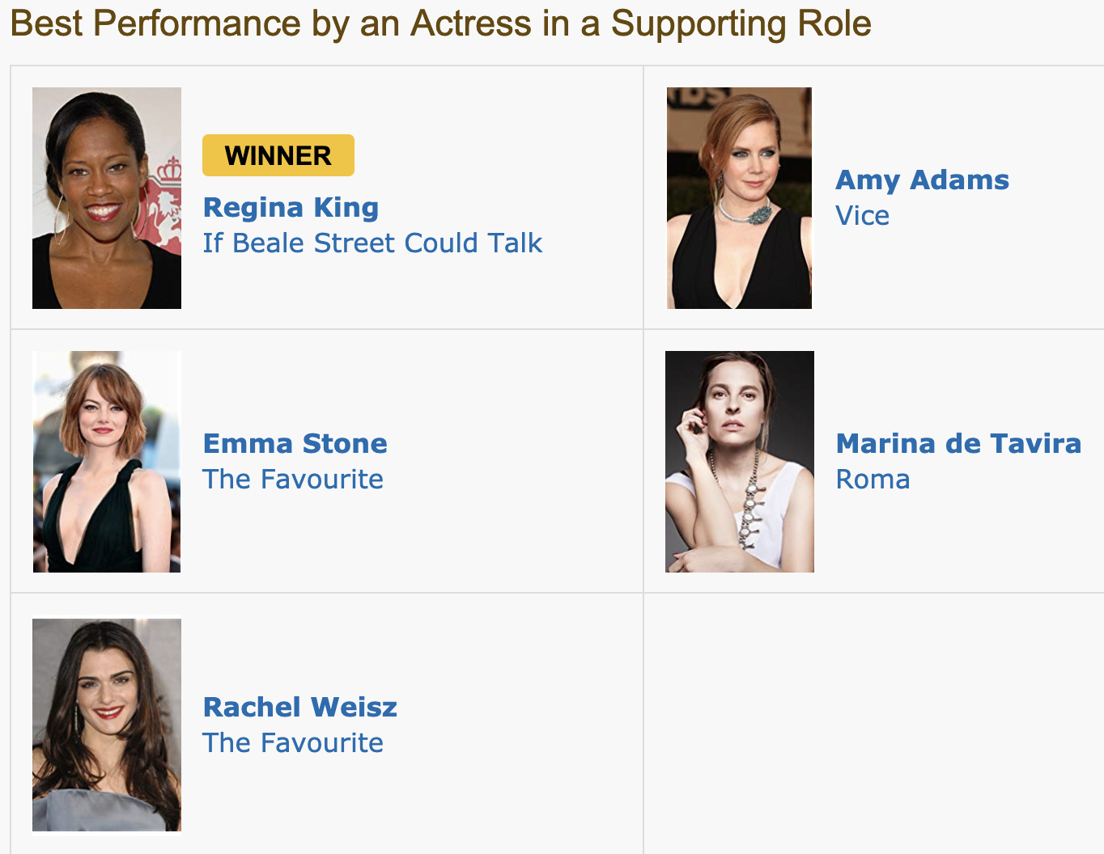
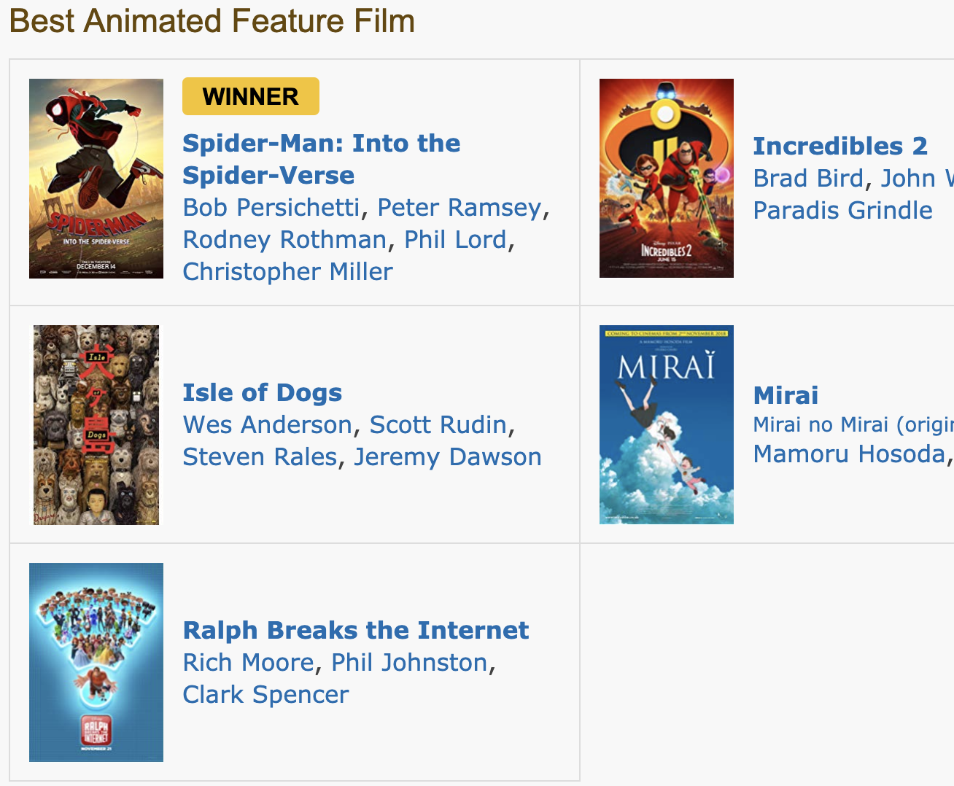

Slide 11
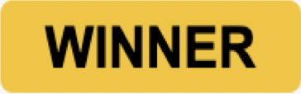
Best Picture
Best Leading Actor
Best Leading Actress
Best Supporting Actor
Best Supporting Actress
Best Animated Film

Slide 12
https://github.com/j0hnk1m/predict-the-oscars
https://github.com/j0hnk1m/predict-the-oscars
https://github.com/j0hnk1m/predict-the-oscars
https://github.com/j0hnk1m/predict-the-oscars
https://github.com/j0hnk1m/predict-the-oscars
https://github.com/j0hnk1m/predict-the-oscars
https://github.com/j0hnk1m/predict-the-oscars
https://github.com/j0hnk1m/predict-the-oscars
https://github.com/j0hnk1m/predict-the-oscars
https://github.com/j0hnk1m/predict-the-oscars
https://github.com/j0hnk1m/predict-the-oscars
https://github.com/j0hnk1m/predict-the-oscars
https://github.com/j0hnk1m/predict-the-oscars
https://github.com/j0hnk1m/predict-the-oscars
https://github.com/j0hnk1m/predict-the-oscars
https://github.com/j0hnk1m/predict-the-oscars
https://github.com/j0hnk1m/predict-the-oscars
https://github.com/j0hnk1m/predict-the-oscars
https://github.com/j0hnk1m/predict-the-oscars
https://github.com/j0hnk1m/predict-the-oscars
https://github.com/j0hnk1m/predict-the-oscars
https://github.com/j0hnk1m/predict-the-oscars
https://github.com/j0hnk1m/predict-the-oscars
https://github.com/j0hnk1m/predict-the-oscars
https://github.com/j0hnk1m/predict-the-oscars
https://github.com/j0hnk1m/predict-the-oscars
https://github.com/j0hnk1m/predict-the-oscars
https://github.com/j0hnk1m/predict-the-oscars
https://github.com/j0hnk1m/predict-the-oscars
https://github.com/j0hnk1m/predict-the-oscars
https://github.com/j0hnk1m/predict-the-oscars
https://github.com/j0hnk1m/predict-the-oscars
https://github.com/j0hnk1m/predict-the-oscars
https://github.com/j0hnk1m/predict-the-oscars

